Slide 1


HackBio Internship 2025: Detecting Depression in University Students
This presentation summarizes a project to develop a machine learning model for detecting depression in university students. The model uses psychological, academic, and lifestyle factors to identify at-risk students for early intervention and mental health support.
by Muhammad Bilal Ashraf

Slide 2



Introduction: The Growing Concern of Depression
Depression is a prevalent mental health disorder characterized by persistent sadness and impaired daily functioning. Among university students, stressors like academic demands and financial pressures contribute to high rates of depressive symptoms, with studies suggesting 30-60% experience these symptoms.
This analysis uses machine learning to develop a classification model for detecting depression, leveraging a dataset with 259 rows after filtering incomplete entries. The goal is to identify at-risk students for early intervention, providing insights into key features and practical advice.
Persistent Sadness
Academic Stress
A key symptom of depression.
A major factor for university students.

Slide 3
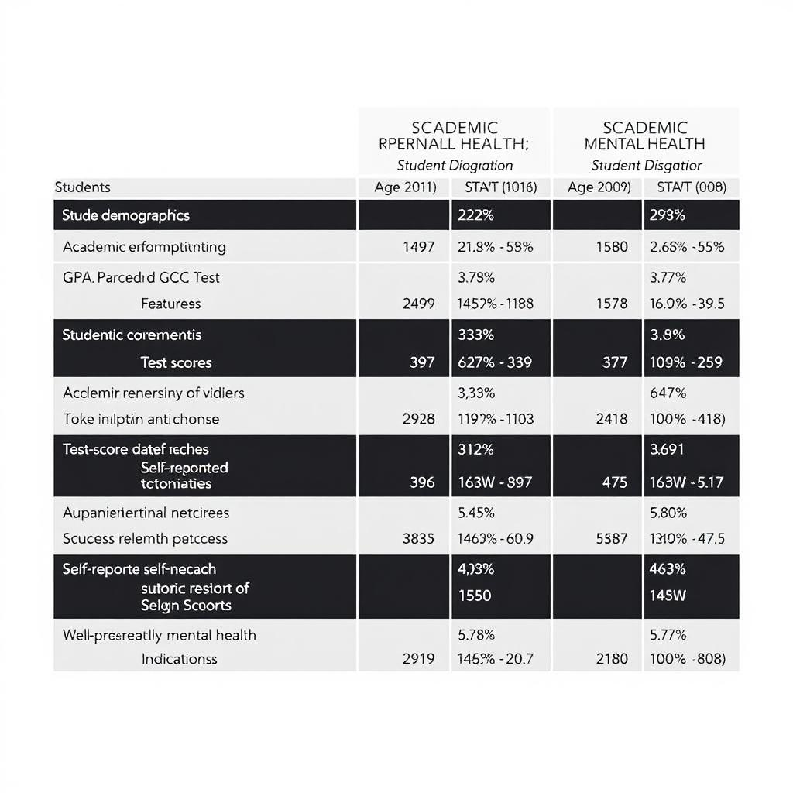
Dataset Overview: Features and Depression Prevalence
The dataset includes 5,581 samples with 15 features and a binary target variable (Depression). Key features include demographics (Gender, Age, Degree), academic factors (Academic Pressure, CGPA), lifestyle factors (Sleep Duration, Dietary Habits), and mental health indicators (Suicidal Thoughts, Family History).
The dataset shows 54.8% of students (142/259) report depression, indicating a significant prevalence. Irrelevant features like "City" and "id" were dropped, focusing on predictive variables.
Demographics
Academic Factors
Gender, Age, Degree
Academic Pressure, CGPA
Lifestyle Factors
Sleep Duration, Dietary Habits

Slide 4




Data Preprocessing: Preparing for Modeling
Data preprocessing steps included encoding categorical variables using LabelEncoder for features like Gender and Sleep Duration. Numerical features such as Age, Academic Pressure, and CGPA were scaled using StandardScaler to ensure optimal model performance.
The data was split into training and testing sets (80-20) using train_test_split, stratifying by the target variable to maintain the proportion of depressed vs. non-depressed students.
Encoding
Convert categorical data.
Scaling
Normalize numerical data.
Splitting
Divide data for training and testing.

Slide 5
Methodology: Classification Models and Hyperparameter Tuning
Three classification models were implemented: Logistic Regression (baseline), Random Forest Classifier, and XGBoost Classifier. GridSearchCV was used to optimize hyperparameters such as n_estimators, max_depth, min_samples_split, and min_samples_leaf.
The models were tuned to capture non-linear relationships and improve performance, with a focus on achieving optimal results for depression detection.
Logistic Regression
Random Forest
XGBoost
Simple baseline model.
Captures non-linear relationships.
Advanced boosting model.

Slide 6
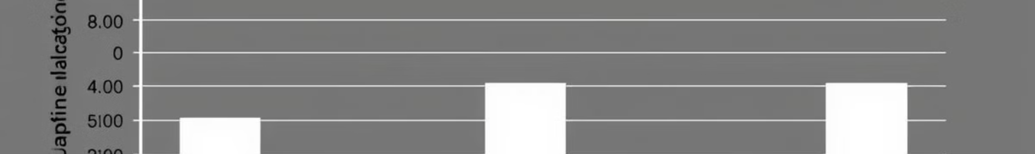
Evaluation Metrics: Recall, AUC-ROC, and F1-Score
Evaluation metrics focused on recall to reduce false negatives, ensuring depressed students are not missed. The AUC-ROC score measured the model's ability to distinguish between classes, and the F1-score balanced precision and recall for overall performance.
Given the sensitivity of depression detection, these metrics were crucial in assessing the effectiveness of the models.
Recall
1
Minimize false negatives.
2
AUC-ROC
Measure class distinction.
F1-Score
3
Balance precision and recall.

Slide 7
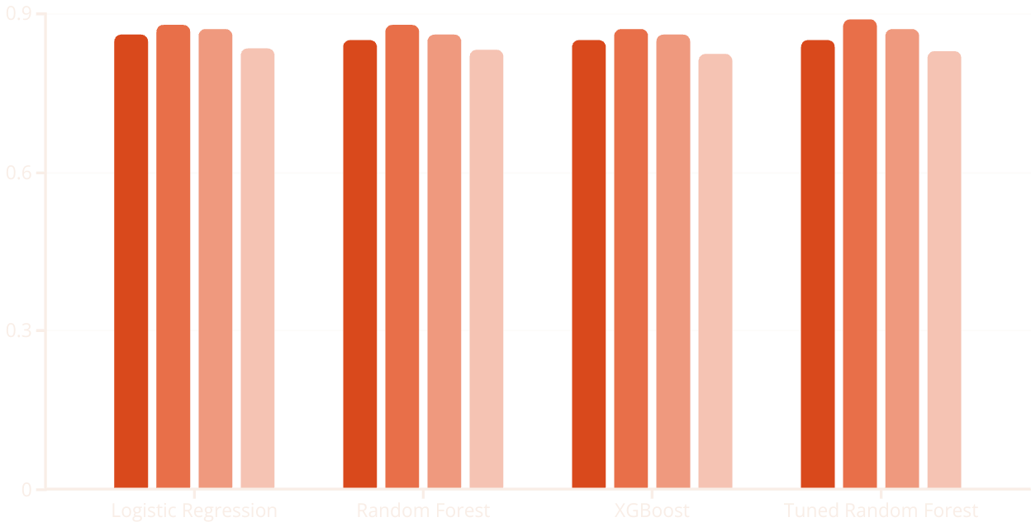
Results: Model Performance Comparison
The tuned Random Forest model achieved the highest recall (0.89), making it the best for detecting depression cases. Logistic Regression had the highest AUC-ROC (0.835), indicating strong discrimination. Overall, the models demonstrated promising performance in detecting depression.
These results highlight the potential of machine learning in identifying at-risk students and providing timely support.
Precision
Recall
F1-Score
AUC-ROC

Slide 8

Conclusion: Potential and Ethical Considerations
This analysis demonstrates the potential of machine learning in detecting depression among university students, with the tuned Random Forest model achieving 89% recall. Key features like suicidal thoughts, academic pressure, and financial stress highlight areas for intervention.
Ethical considerations and data limitations suggest further research and cautious application in real-world settings. Future improvements include exploring deep learning, handling class imbalance, and collecting more data.
1
Ethical Considerations
2
Future Improvements
Privacy and bias in data.
Deep learning and more data.

